Slide 1
Basic Networking Commands CS F303
Dr. Pranav M. Pawar

Slide 2
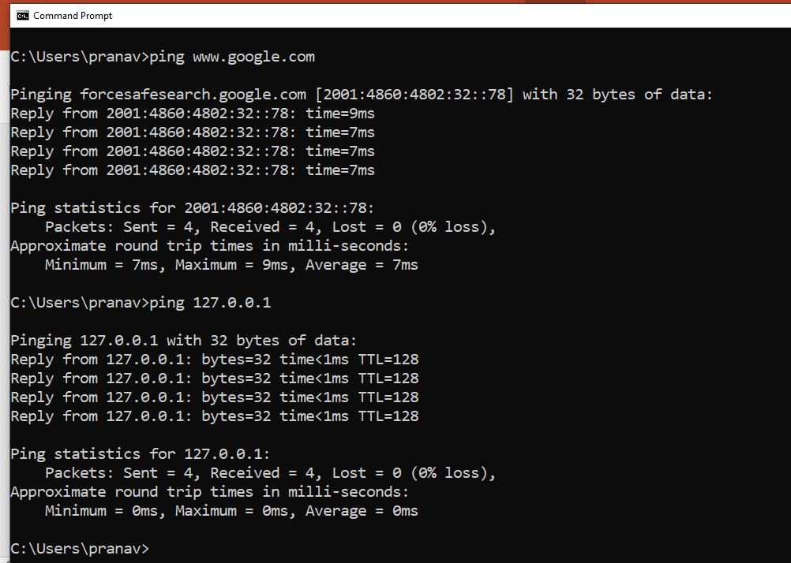
ping
With it you’re able to send an echo request to a device locally, or on the Internet, and receive a reply.

Slide 3
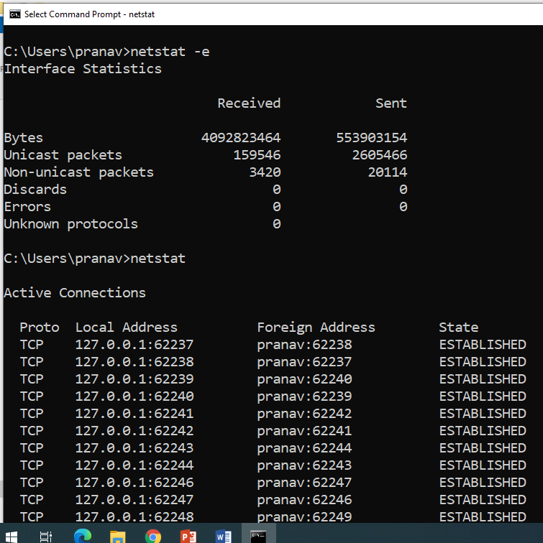
netstat
Stands for Network Statistics, this command will display connection information, routing tables and so on.
Entering the command will display what’s going on while you use the network and Internet.
Display incoming and outgoing network connections
Display routing tables (netstat –r)
Display number of network interfaces
Display network protocol statistics (netstat –s)

Slide 4
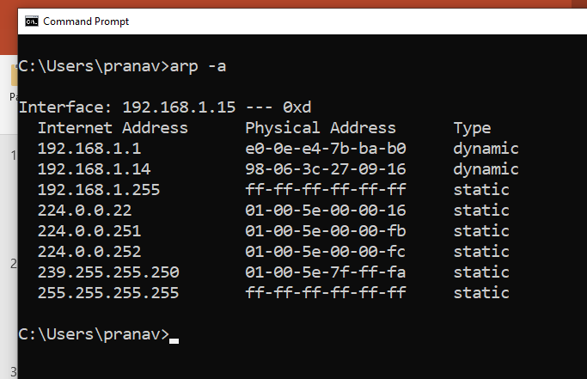
arp
Stands for Address Resolution Protocol displays and modifies entries in the ARP cache, which contains one or more tables that are used to store IP addresses and their resolved Ethernet or Token Ring physical addresses.

Slide 5
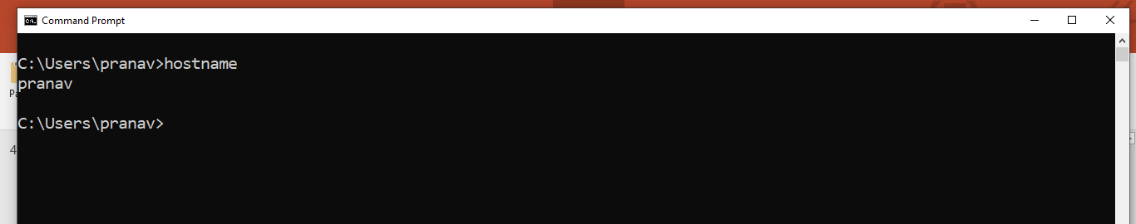
hostname
To find the name of a Windows computer you’ve got on your network.

Slide 6
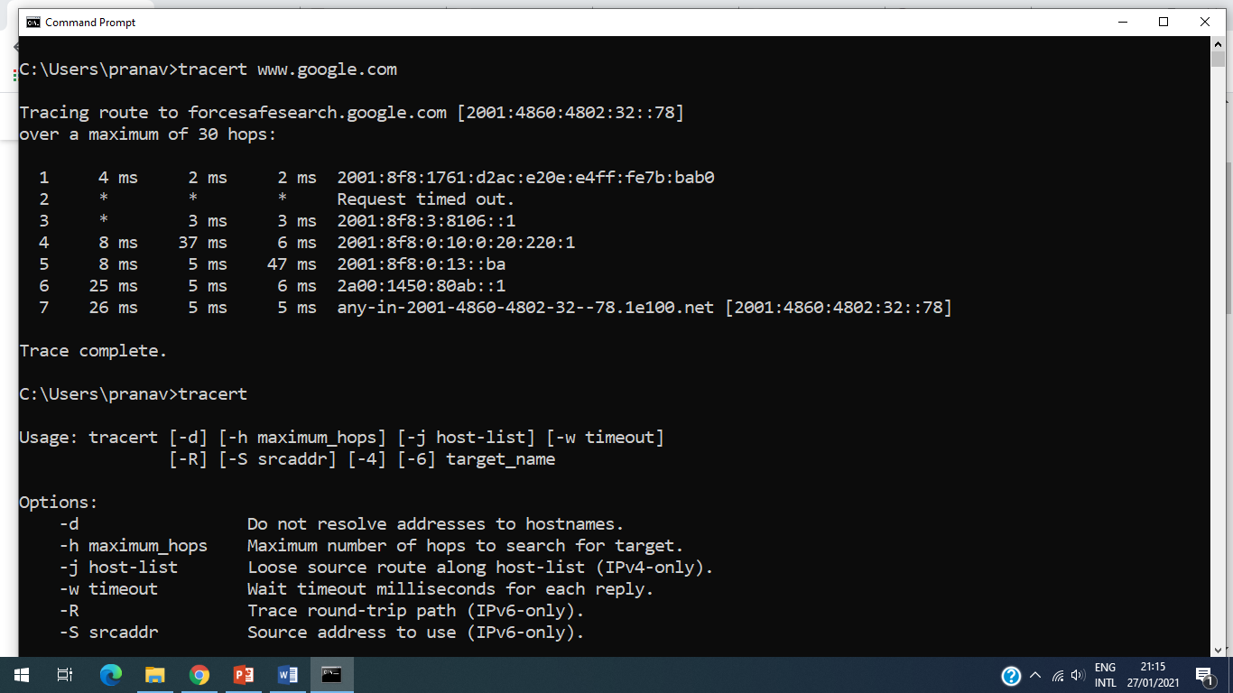
tracert
Stands for Trace Route will examine the path to a remote computer, either locally or on the Internet.
It will display the hops taken over networking devices.

Slide 7
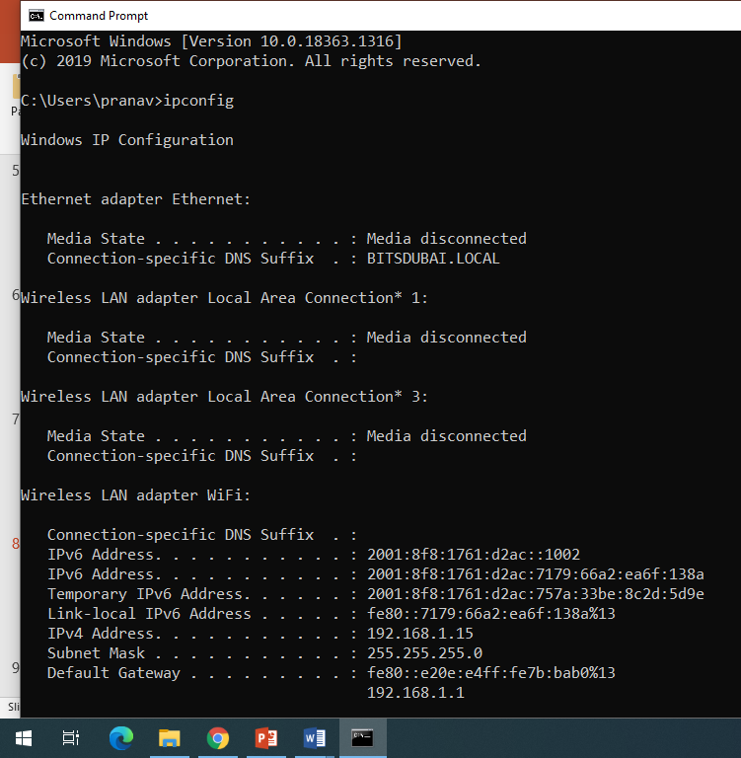
ipconfig
ipconfig will display information on the local computer’s network interfaces, such as IP addresses (both IPv4 and IPv6), Hostname, gateway and so on.

Slide 8
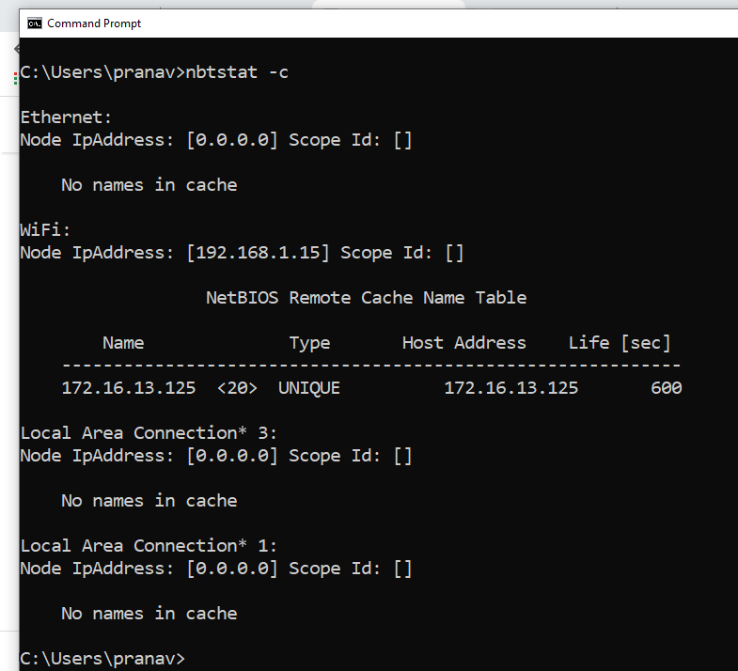
nbtstat
The nbtstat command is a diagnostic tool for NetBIOS over TCP/IP.
Its primary design is to help troubleshoot NetBIOS name resolution problems.
It’ll display the human-friendly names of devices on the network along with their IP addresses.

Slide 9
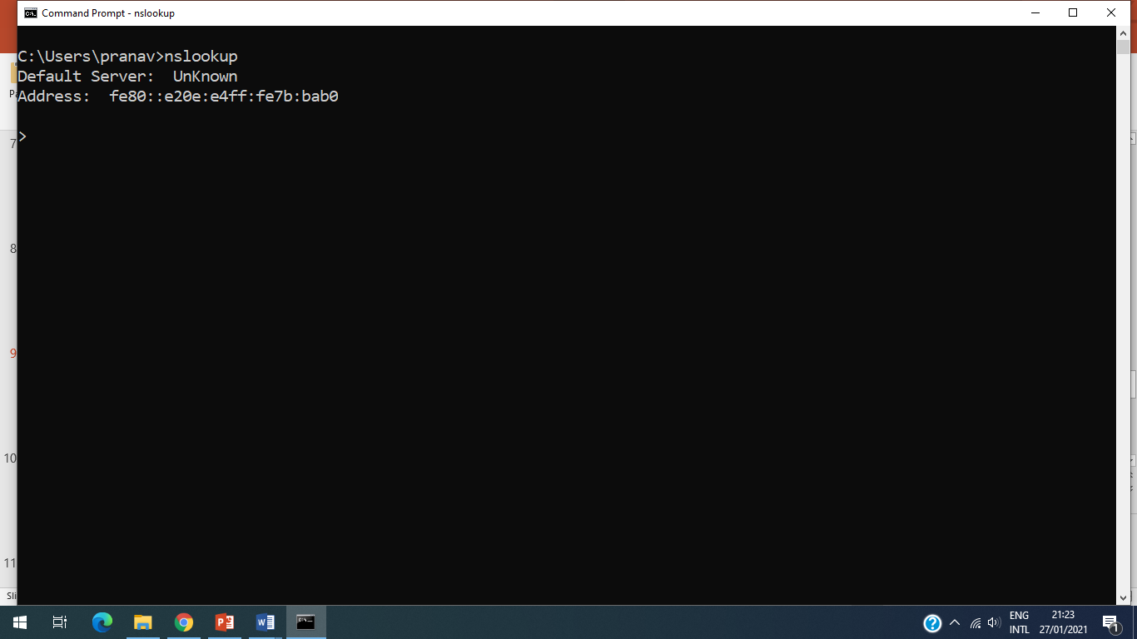
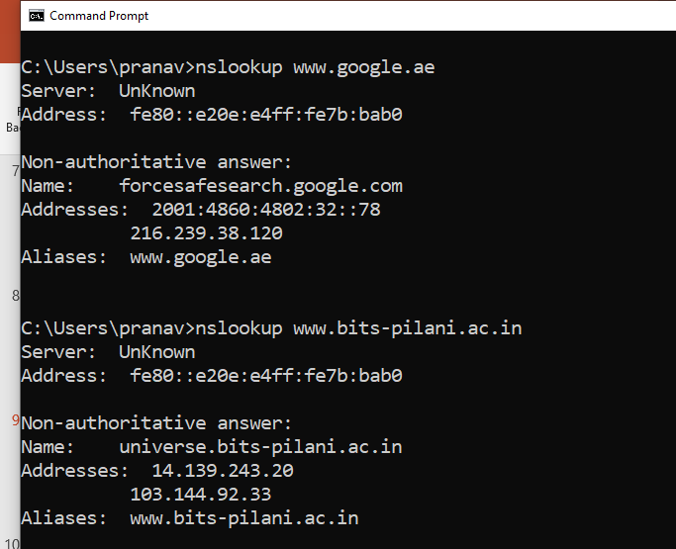
nslookup
It is used to look up the and diagnose the Domain Name System (DNS) of a location on the local network or Internet.

Slide 10
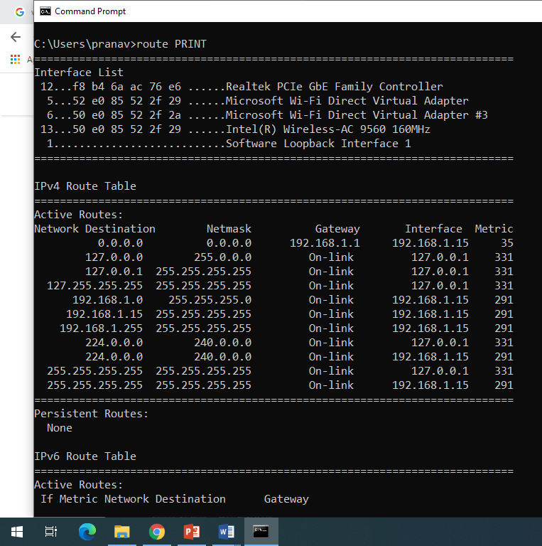
route
Allows you to view the device’s routing tables.
This will print the network interfaces, IPv4 and IPv6 route tables.

Slide 11
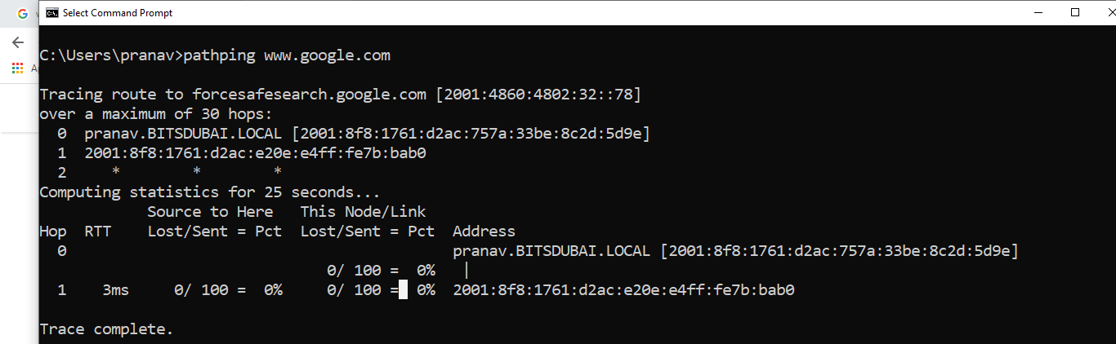
pathping
This is a handy command that combines the best elements of Ping and Tracert.
It will display the latency and packet loss between one computer and another (either locally or on the Internet), and after few seconds display a detailed report.

Slide 12
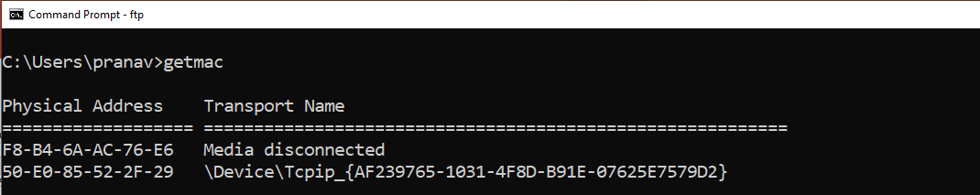
getmac
Get the MAC address of a windows computer

Slide 13
Student Task
Try out all commands.
Try different variations of the commands.
Find more networking commands for windows system.
List and try commands for Linux system.

Slide 14
Sources
https://bdmpublications.com/windows-networking-command-cheat-sheet/
https://cmdref.net/os/windows/command/index.html
https://mindmajix.com/linux-networking-commands-best-examples
https://geekflare.com/linux-networking-commands/

Slide 15
Thank You!

